Slide 1
Family Court
Improving the user experience

Slide 2
Ideation for solutions

Slide 3
Think of a scavenger hunt…information is shared in a phased manner, with only enough helping you get to the next step
Process –
List ideas that may solve the evident issues around keeping the user informed
MashUp –
Airport
Restaurant
Parking spaces
Metro stations
Hotels

Slide 4
Steps
Before entering the system
Security
Information desk
Information on floor 1
Waiting
Signage
Others

Slide 5
Before entering the system
D: Defendant
P: Plaintiff
P: On filing online
Ticket confirmation information sent on mail (airline ticket)
Report at ____
Process
What to expect
Push SMS – Please check in at the counter on 1st floor after clearing security
D- A sheet that gives the process:
You may need representation
Once you clear security, please check in at _____________
Please report to floor 3, court 3A12
Carry print out of this sheet
For queries ,please call 1800- fhj-fhjd
D: While notifying the litigant, the caseworker reads a script sharing process and things to expect
Expectations
Please expect to be there for 1-6 hours
Dressing –
Please carry any medication you might need
Redesigning the notice for better understanding (current ones are wordy/have legal words and put in 1 big para.)

Slide 6
At security
Flyers are handed by the security personnel to people coming in. Flyers have simple questions in layman language to help users identify what they are there for, and understand the NEXT STEP (WHERE they need to go and WHAT they need to do)
Is your partner…
FLOOR 1
Is parent’s drug abuse impacting child?
FLOOR 2
Is your partner not respecting custody order?
Is your partner not respecting child support order?
_____
FILL YELLOW FORM
GO TO self help center on Floor1
Are you being threatened by someone?
FLOOR 3
FLOOR 4
FLOOR 5
For any query, contact information desk
Person knows they have to go to self help center at floor 1

Slide 7
At security
Pre informing the user of the things they should take out / things they cant carry before they reach the point at which they start taking out the prohibited material.
Impact – spending less time once people reach, don’t have to be told by the personnel, don’t hold up the line

Slide 8
Information desk
At the info desk, Person fills out a form answering quick questions (written in layman language), which help person at info desk direct them accurately.
Questions –
Child trouble
Is your child not going to school / misbehaving
Partner trouble
Is your partner
Y
N
Person at info desk is trained on this and also has a quick reference guide of where to direct basis responses

Slide 9
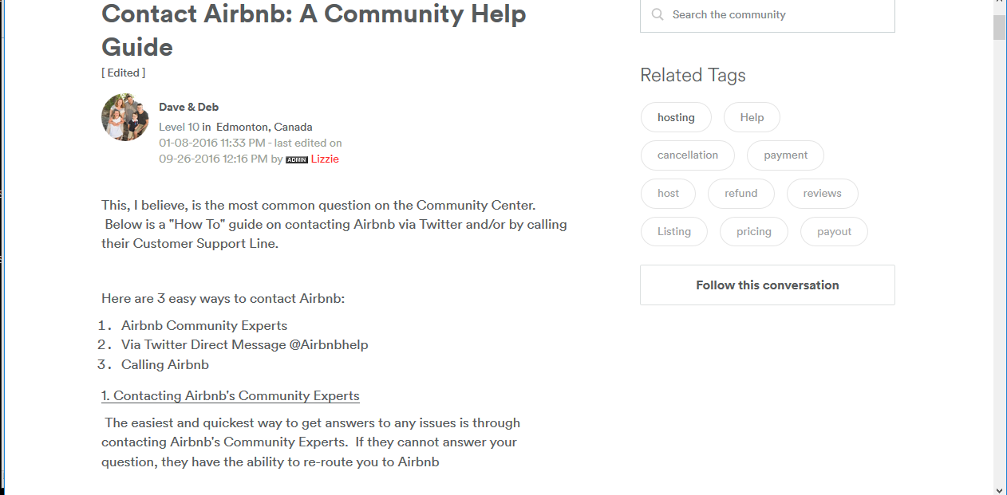
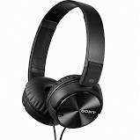
Self help Kiosks (and using the same thing in training)
Airbnb type community help
My child is acting up
Help topics, ability to tag keywords
Reducing people dependency and language barriers
Wrong forms get filled (lara)
Too many forms, don’t know which to fill (photo outside self help)
People who have been helped by the system, help people coming in for the first time (similar to YSP)

Slide 10
Filling forms in person (at Self help)
We suggest expanding the role of the self help center to become the starting point of filling forms for all type of cases, and being directed to the relevant department
With the information from the previous stage, where person understand what form they have to fill, they pick and fill that colored form
Filing a petition in person
On submitting the form,
Ticket confirmation information
Report at ____
Process
What to expect

Slide 11
Wayfinding - Elevator (hotel)
Color coded (same as flier)
Information about what is on each floor on each colored section
https://segd.org/sites/default/files/styles/galleryformatter_slide/public/SA%20elevator%20090.jpg?itok=vgTMRbft

Slide 12
Signage
Floor signage to indicate where to go.
Color coded for each department
https://2.bp.blogspot.com/-ZajEteJ6zj4/VzKKoZHzF-I/AAAAAAAACmA/CB_vQGyBPOgkd6kPFXvB-bNyct6WIPO0QCLcB/s1600/TMR-Hamamatsucho-02.JPG

Slide 13
Signage – Floor signage on Floor 1
1 is for the floor number
A is for the different corridors
10-15 is for the different room numbers
Signs in the corridors
1B16 –
1B20
1 A 10 -
1 A 15
1A10 –
1A15
1C21 –
1C26

Slide 14
Outside courtroom signage
Provides feedback on when the next case will be ready
Room 203
Case Number: 940
Start Time: 10:40 AM
Estimated Finish: 11:30 AM
Next up: 953

Slide 15
Basic signage improvements/getting rid of confusing parts
Juvenile court/waiting area signage on floor 1
So many forms near self help
How to know which to pick?
Too much content to pick on first glance
No labeling of the form
Some signs without arrows
Reducing signs near the metal detectors

Slide 16
Waiting area – Scheduling
Case | Scheduled time | Estimated time
31 | 10:00 AM | 10:00 AM
33 | 10:00 AM | 10:30 AM
40 | 11:00 AM | 11:00 AM
** If we have an idea of average time for different type of cases, ex. Average time for delinquency cases (on observing court sessions 1 day, I saw delinquency cases going faster, but that is just data of one day)
IF we do not have that data, then only giving start time of current case, and case numbers for the next cases
http://www.malagaweb.com/images/malaga-airport/malaga-airport-departures.jpg

Slide 17
Waiting area - Notification
PA
One floor, then an all building announcement
Text message notifications when your case is next

Slide 18
Token system
Impact –
Allows better communication within the system about each client
If average time for different types of cases is known, then this can be used by the child care center to assess when they can take the next child
Handed a digital token when they enter (could be same for case number)
Exited
Processing
As they move through the system, their status is updated which allows people within the system to understand where they are
EXAMPLE
Child care center
Current occupancy: 5
Spots remaining: 1
Waiting
Person at the center can check the status of where the parent of the child in the system is, and update the board accordingly

Slide 19
Uniforms/ID card
A way for plaintiffs to know who they can talk to in the courthouse to learn more information

